Slide 1
Causes of Declining Fertility in Iceland
Vilmundur Torfason and Gylfi Zoega
PRICE presentation
12 June 2025
Notes:
In this presentation we are going to take a look at changes in fertilty in iceland

Slide 2
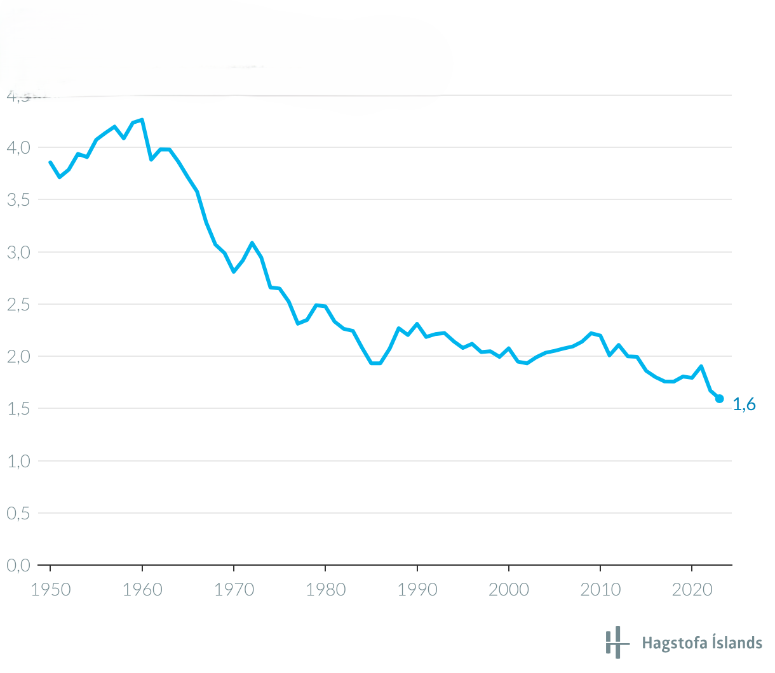
Total fertility rate in Iceland
Fertility has declined after 2014 in spite of:
Economic growth,
increased parental leave,
gender equality,
the last two of which should be conducive to partners agreeing on having children.
Parents share 12 months of parental leave in Iceland plus children in pre-school from age 2.
Notes:
-Iceland has traditionaly

Slide 3
Contribution of study
Event study shows the effect of the birth of a first child on:
Cohabitation
Home ownership
Differences in disposable income
We relate fertility in Iceland to
socioeconomic variables, in addition to age:
Mother’s disposable income.
Spouse or no spouse (binary).
Partner’s disposable income.
Employment status (binary = 1 if unemployed).
Home ownership (binary).
Mother’s parent’s disposable income.
Immigrant or native (binary = 1 if immigrant).
Education.
From this we will conclude about the causes of the recent decline in fertility.

Slide 4
Data
Annual administrative tax records from all Icelandic taxpayers from 2014 to 2022.
Collected by Statistics Iceland and Iceland Revenue and Customs.
Linked with other administrative data and therefore include socio-demographic factors as well.
Data include information on age, gender, education, marital status, occupation, and number of children.

Slide 5
Data
Children under the age of 17 are included in the tax returns of the parents. Distinction made between 0-7 and 8-16 years of age.
We identify a birth as the year when the number of children increases by one.
Based on the number of pre-existing children, we count the births as first, second and third.

Slide 6
OLS – Cross section
Dependent variable: 0 if no birth, 1 if birth
Women between 16 and 50
 | Cross section 2022
Variables | First child |  |  | Second child |  |  | Third child
Intercept | -0,0128 | (0,0081) |  | -0,1177 | (0,0067) | *** | -0,0787 | (0,0046) | ***
Age | 0,0038 | (0,0005) | *** | 0,0098 | (0,0005) | *** | 0,0058 | (0,0003) | ***
Age squared | -0,00009 | (0,000007) | *** | -0,0002 | (0,000007) | *** | -0,00009 | (0,000005) | ***
Unemployment (binary) | 0,0062 | (0,0039) |  | 0,0070 | (0,0038) | . | 0,0018 | (0,0025)
Female disposable income (m) | -0,0097 | (0,0003) | *** | -0,0013 | (0,0003) | *** | -0,0004 | (0,0001) | **
Spouse disposable income (m) | -0,0007 | (0,0002) | *** | -0,0001 | (0,0002) |  | 0,0001 | (0,0001)
Immigrant (first and second gen.) | 0,0067 | (0,0059) |  | -0,0081 | (0,0032) | * | -0,0006 | (0,0023)
Spouse (binary) | 0,0243 | (0,0029) | *** | 0,0328 | (0,0026) | *** | 0,0161 | (0,0014) | ***
Home ownership (binary) | 0,0219 | (0,0024) | *** | 0,0156 | (0,0019) | *** | 0,0012 | (0,0011)
Disposable income of parents (m) | -0,00001 | (0,000008) |  | -0,000001 | (0,00001) |  | -0,000002 | (0,000003)
Secondary school (binary) | -0,0001 | (0,0018) |  | -0,0035 | (0,0016) | * | -0,0024 | (0,0011) | *
Other post-primary school (binary) | 0,0043 | (0,0044) |  | -0,0092 | (0,0038) | * | -0,0099 | (0,0022) | ***
University (short) (binary) | 0,0184 | (0,0075) | * | 0,0048 | (0,0066) |  | -0,0076 | (0,0030) | *
University BSc (binary) | 0,0086 | (0,0022) | *** | 0,0009 | (0,0021) |  | -0,0045 | (0,0014) | **
University MSc (binary) | 0,0134 | (0,0026) | *** | 0,0048 | (0,0026) | . | 0,0006 | (0,0018)
PhD (binary) | 0,0132 | (0,0079) | . | 0,0027 | (0,0079) |  | 0,0065 | (0,0078)
Multiple R-squared | 0.0210 |  |  | 0.0296 |  |  | 0.0138
Adjusted R-squared | 0.0207 |  |  | 0.0293 |  |  | 0.0135
F statistic | 72.17 |  |  | 102.7 |  |  | 47.24
Standard errors in parentheses. ***' 0.001 '**' 0.01 '*' 0.05 '.' 0.1 '
Notes:
Results seem to suggest age has an effect
Probability of having a child seems to decline with female disp. Income as well as spouces but less
Does not depend on disposable income of parents
Instead it is living together that matter. Cohabitiation, having a spouce and owning a home
Having a University degree seems affect the probability of having a first child, but less so second and third
Big picture is that what is important is to be in a relationship, to live with someone in your own house.

Slide 7
Age effects (cross section 2022)
(after controlling for other variables)
Maximum: 20.5
Maximum: 28.8
Maximum: 31.9
Notes:
Age effects show the non-liner effect of age and there is a peak just after 20.
Which says that women are most likey to have a child just after 20,
After controlling for other variables
In reality it is later, but the age effect on its own gives you a peak just after 20

Slide 8
Trend in the age of mother at first birth
Figure plots the peak of the age distribution for each year, derived from cross section regressions when only the age variables are included.
 | 2014 | 2015 | 2016 | 2017 | 2018 | 2019 | 2020 | 2021 | 2022
Max age effect | 27,84927857 | 28,48278082 | 28,77444156 | 29,2497642 | 29,6165909 | 29,8197199 | 29,98723065 | 30,07158869 | 29,44621634
Notes:
Now we can plot the peak of the age distribution for each year
Derrived from cross section regressions
When only the age variables are included
So we take the peak of the age effect of the cross section for 2014, 2015 …
And when we do this we omit all other variables
And here you can see that the age of first birth has been increasing over time

Slide 9
Share of women cohabiting
Biggest fall in share cohabiting.
Notes:
A plausable reason why the age of first birth has been increasing is that the share of women cohabiting,
That is living with a spouce,
Has been declining
Especially for the 25-29, 30-34 and 35-39
So since the coefficient of cohabiting is positive in the regression analysis
A decline in the share of cohabiting could explain why they are postponing childbirth, having children later

Slide 10
OLS – pooled regression
Dependent variable: 0 if no birth, 1 if birth
Women between 16 and 50
Same pattern as in cross section but more significance.
 | Pooled – 2014-2022
Variables | First child |  |  | Second child |  |  | Third child
Intercept | -0,0380 | (0,0022) | *** | -0,1015 | (0,0020) | *** | -0,0757 | (0,0015) | ***
Age | 0,0051 | (0,0001) | *** | 0,0088 | (0,0001) | *** | 0,0059 | (0,0001) | ***
Age squared | -0,0001 | (0,000002) | *** | -0,0002 | (0,000002) | *** | -0,0001 | (0,000002) | ***
Unemployment | 0,0116 | (0,0011) | *** | 0,0098 | (0,0010) | *** | 0,0006 | (0,0007)
Female disposable income (m) | -0,0003 | (0,0001) | ** | -0,0006 | (0,0001) | *** | -0,0005 | (0,00007) | ***
Spouse disposable income (m) | -0,0008 | (0,0001) | *** | -0,00009 | (0,0001) |  | 0,0003 | (0,00006) | ***
Immigrant (first and second gen.) | -0,0048 | (0,0015) | ** | -0,0034 | (0,0011) | ** | 0,0001 | (0,0008)
Spouse (binary) | 0,0291 | (0,0011) | *** | 0,0432 | (0,0011) | *** | 0,0150 | (0,0006) | ***
House ownership (binary) | 0,0118 | (0,0008) | *** | 0,0116 | (0,0006) | *** | 0,0035 | (0,0004) | ***
Disposable income of parents (m) | -0,000002 | (0,000008) |  | 0,000006 | (0,000007) |  | -0,000004 | (0,00003)
Secondary school (binary) | 0,0041 | (0,0005) | *** | -0,0047 | (0,0005) | *** | -0,0047 | (0,0003) | ***
Other post-primary school (binary) | 0,0056 | (0,0013) | *** | -0,0049 | (0,0013) | *** | -0,0057 | (0,0010) | ***
University (short) (binary) | 0,0099 | (0,0016) | *** | -0,0018 | (0,0015) |  | -0,0053 | (0,0011) | ***
University BSc (binary) | 0,0113 | (0,0007) | *** | -0,0008 | (0,0006) |  | -0,0041 | (0,0005) | ***
University MSc (binary) | 0,0144 | (0,0008) | *** | 0,0044 | (0,0008) | *** | 0,0005 | (0,0006)
PhD (binary) | 0,0110 | (0,0026) | *** | 0,0010 | (0,0026) |  | 0,0007 | (0,0024)
Multiple R-squared | 0.0197 |  |  | 0.0284 |  |  | 0.0156
Adjusted R-squared | 0.0196 |  |  | 0.0284 |  |  | 0.0155
F statistic | 407.9 |  |  | 595.8 |  |  | 321.6
Standard errors in parentheses. ***' 0.001 '**' 0.01 '*' 0.05 '.' 0.1 '
Notes:
This is the results of pooled regression for 2014-2022
Here the pattern is the same as in the cross section but there is more significanse
Almost identical to cross section 2022

Slide 11
Age effects (pooled 2014-2022)
Maximum: 23.1
Maximum: 28.1
Maximum: 29.5
Notes:
Quite similar to the ones before
Age profile
Which indicates that women are postponing having their first child.

Slide 12
Time trends
Fall in the number of third childs born.
Notes:
Time trends from the pooled regression
Show a fall in the number of third births
And effects of covid-19
Time fixed effects
Downward trend over time to have a third child

Slide 13
Event study
Notes:
Here we normalized the share of women who own their own home
As being zero one year before the event of having a first child
So the year of the first birth this goes up by 10% and then another 6-7%
Two years later there is a 20% increase in the share of women who own their own home
-Here it showes the start of home ownership
That is buying your first appartment
Increases the year of birth and then further up in the second and third year
So child birth coincides with the buying of your own home
And childbirth coincides with cohabitation
This seemes to be because the child birth makes them move together
And here you can see the gender wage difference increases in the year of first birth, the year after and stays up
That means that the wage of the father which was the same as the mothers in the year before the birth will become higher in the year of the birth and year after

Slide 14
Summary
Fertility depends on
Age
Disposable income of wife and disposable
income of spouse (positive if third child)
Cohabitation
Home ownership
COVID-19
Education (positive for first child, negative for second and third)
Fertility does not depend on
Parent’s disposable income (mother’s)
Immigrant versus native
Event study shows
Rising home ownership before and after birth
Start of cohabitation in year of birth
Increasing gender inequalty before and after birth
Notes:
To summarize

Slide 15




Causes of the fall in fertility
Lower fertility possibly due to:
Fall in the number of third births, and
postponement of having a first child.
Possible reasons
Fear of the future
Female empowerment
Social media and computer games
Rising house prices
Notes:
Not wanting to take long term decissions
That women don’t need a husband in the same way as before
Increased isolation with non-social entertainment, that is you don’t need to meet people
This could all contribute to a decline in the share of women in cohabtiation, which then would increase post-ponment

Slide 16



Literature
Esping-Andersen and Billari (2015): Gender egalitarian norms and accompanying social institutions are prerequisite for elevated fertility.
McDonald (2000): High fertility in the Nordic countries and high participation rates for women attributed to welfare states.
Jónsson (2017): Fertility between 1980 and 2010 (TFR) average around 2.1 children per woman and was among the highest in Europe, higher than in the other Nordic countries.
Jónsson (2024): The fertility decline in Iceland after 2010 is concentrated around first births for women under the age of 30. Postponement of parenthood but not lower propensity to have a second and a third child.
Comolli et al. (2021): Fertility fell in all the Nordic countries after the great recession. One explanation could be perceived uncertainties about the future making it difficult to imagine a future path in life. Globalization, smartphones, social media, pandemics and wars. Shared narratives across countries.

Slide 17
Age effects (maka breytu sleppt)
Maximum: 23.1
Maximum: 30.1
Maximum: 32.8

Slide 18
Age effects (öllum breytum nema Age & Age^2 sleppt)
Maximum: 29.45
Maximum: 32.8
Maximum: 34.3

Slide 19
Hlutfall í sambúð

Slide 20
Age effects (maka breytu sleppt)
Maximum: 25.5
Maximum: 29.6
Maximum: 32.0

Slide 21
Age effects (öllum breytum nema Age & Age^2 sleppt)
Maximum: 29.37
Maximum: 32.2
Maximum: 33.7
Age of first birth higher in 2022, 29.45.

Slide 22
Explaining lower fertility between 2016 and 2022
First birth
Number of women who had a first child dived by the total number of women aged 16 to 50.
 |  | Birth rate (first) | Unempl.ment | Disposable income | Spouse | Immigrants | Home ownership | Age | Age^2 | Year dummy
(1) | Coefficient |  | 0,0116 | -0,0003 | 0,0291 | -0,0048 | 0,0118 | 0,0051 | -0,0001
(2) | 2016 | 0.0189 | 0,0537 | 4,0901 | 0,4129 | 0,1711 | 0,4445 | 32,42 | 1.051,1 | -0.0029
(3) | 2022 | 0.0217 | 0,0653 | 4,7560 | 0,4205 | 0,2781 | 0,4816 | 33,44 | 1.117,3 | 0.0008
(4) | Difference | 0.0028 | 0,0116 | 0,6659 | 0,0076 | 0,1070 | 0,0371 | 1,0149 | 66,1737 | 0.0037
(5) | (1)*(3-2) |  | 0,0001 | -0,0002 | 0,0002 | -0,0005 | 0,0004 | 0,0052 | -0,0066
(6) | Total effect |  | -0,0014 |  |  |  |  |  |  | 0.0023
Notes:
contribution to explaining the change in birth rate.
difference in birth rate is due to the time trend
the year dummy is more important than all these variables in explaining the changes

Slide 23
Second birth
 |  | Birth rate (second) | Unempl.ment | Disposable income | Spouse | Immigrants | Home ownership | Age | Age^2 | Year dummy
(1) | Coefficient |  | 0,0098 | -0,0006 | 0,0432 | -0,0034 | 0,0116 | 0,009 | -0,0002
(2) | 2016 | 0.0173 | 0,0537 | 4,0901 | 0,4129 | 0,1711 | 0,4445 | 32,42 | 1.051,1 | -0.0023
(3) | 2022 | 0.0177 | 0,0653 | 4,7560 | 0,4205 | 0,2781 | 0,4816 | 33,44 | 1.117,3 | -0.0007
(4) | Difference | 0.0004 | 0,0116 | 0,6659 | 0,0076 | 0,1070 | 0,0371 | 1,0149 | 66,1737 | 0.0016
(5) | (1)*(3-2) |  | 0,0001 | -0,0004 | 0,0003 | -0,0004 | 0,0004 | 0,0089 | -0,0132
(6) | Total effect |  | -0,0042 |  |  |  |  |  |  | -0.0026
Notes:
contribution to explaining the change in birth rate
difference in birth rate is due to the time trend
the year dummy is more important than all these variables in explaining the changes

Slide 24
Third birth
 |  | Birth rate (third) | Unempl.ment | Disposable income | Spouse | Immigrants | Home ownership | Age | Age^2 | Year dummy
(1) | Coefficient |  | 0,0006 | -0,0005 | 0,0150 | 0,0001 | 0,0035 | 0,0059 | -0,0001
(2) | 2016 | 0.0095 | 0,0537 | 4,0901 | 0,4129 | 0,1711 | 0,4445 | 32,42 | 1.051,1 | 0.0005
(3) | 2022 | 0.0074 | 0,0653 | 4,7560 | 0,4205 | 0,2781 | 0,4816 | 33,44 | 1.117,3 | -0.0019
(4) | Difference | -0.0021 | 0,0116 | 0,6659 | 0,0076 | 0,1070 | 0,0371 | 1,0149 | 66,1737 | -0.0024
(5) | (1)*(3-2) |  | 0,00001 | -0,0003 | 0,0001 | 0,00001 | 0,0001 | 0,0060 | -0,0066
(6) | Total effect |  | -0.0007 |  |  |  |  |  |  | -0.0031
Notes:
contribution to explaining the change in birth rate
difference in birth rate is due to the time trend
the year dummy is more important than all these variables in explaining the changes

